Slide 1
COMBINATIONAL CIRCUITS
COMPUTER SYSTEM ARCHITECTURE
BY:
ROSHNI PATOA

Slide 2
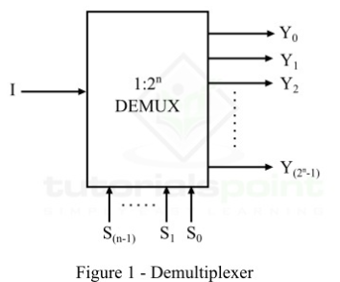
DE-MULTIPLEXER
A de-multiplexer is a combinational circuit that has 1 input line and 2^n output lines. A multiplexer is a single-input and multi-output combinational circuit. The information is received from the single input lines and directed to the output line. On the basis of the values of the selection lines, the input will be connected to one of these outputs. De-multiplexer is opposite to the multiplexer.

Slide 3
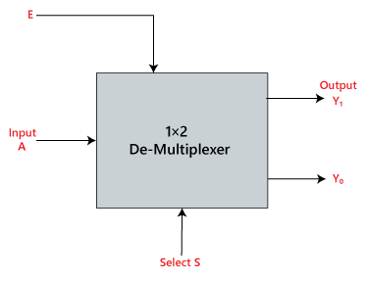
1x2 de-MULTIPLEXER
In the 1 to 2 De-multiplexer, there are only two outputs, i.e., Y0, and Y1, 1 selection lines, i.e., S0, and single input, i.e., A. On the basis of the selection value, the input will be connected to one of the outputs. The block diagram and the truth table of the 1×2 multiplexer are given below.

Slide 4
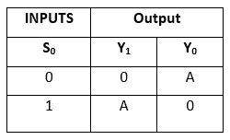
Truth Table for 1X2 de-MULTIPLEXER
The logical expression of the term Y is as follows:
Y₀=S₀'.A Y₁=S₀.A

Slide 5
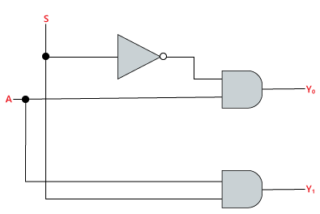
LOGIC DIAGRAM for 1X2 de-MULTIPLEXER

Slide 6
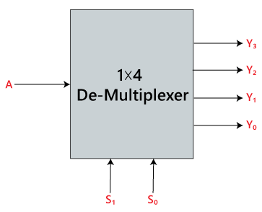
1x4 de-MULTIPLEXER
In 1 to 4 De-multiplexer, there are total of four outputs, i.e., Y0, Y1, Y2, and Y3, 2 selection lines, i.e., S0 and S1 and single input, i.e., A. On the basis of the combination of inputs which are present at the selection lines S0 and S1, the input be connected to one of the outputs. The block diagram and the truth table of the 1×4 multiplexer are given below.

Slide 7
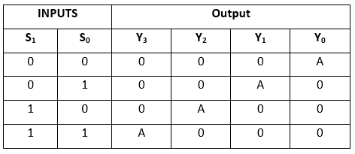
Truth Table for 1x4 de-MULTIPLEXER
The logical expression of the term Y is as follows:
Y0=S1'S0’A Y1=S1'S0A Y2=S1S0’A
Y3=S1 S0 A

Slide 8
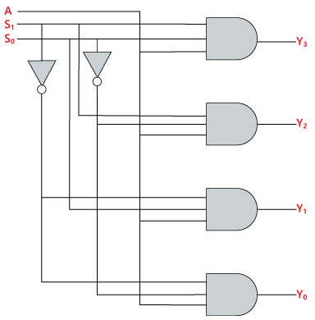
LOGIC DIAGRAM for 1X4 DE-MULTIPLEXER

Slide 9
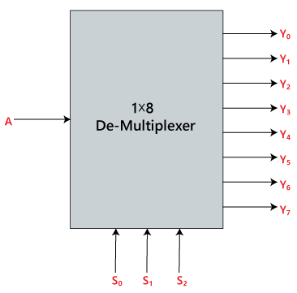
1X8 DE-MULTIPLEXER
In 1 to 8 De-multiplexer, there are total of eight outputs, i.e., Y₀, Y₁, Y₂, Y₃, Y₄, Y₅, Y₆, and Y₇, 3 selection lines, i.e., S₀, S₁and S₂ and single input, i.e., A. On the basis of the combination of inputs which are present at the selection lines S⁰, S¹ and S₂, the input will be connected to one of these outputs. The block diagram and the truth table of the 1×8 de-multiplexer are given below.

Slide 10
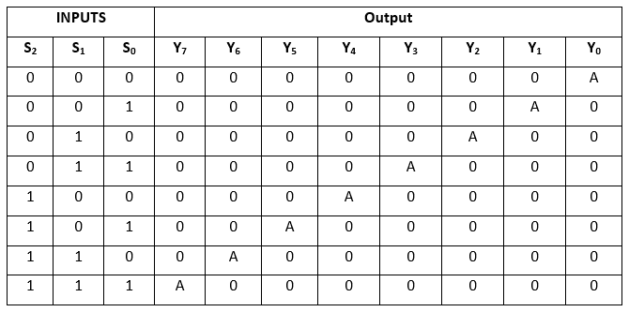
Truth Table for 1X8 DE-MULTIPLEXER
The logical expression of the term Y is as follows:
Y₀=S₀'.S₁'.S₂'.A Y₁=S₀.S₁'.S₂'.A Y₂=S₀'.S₁.S₂’.A
Y₃=S₀.S₁.S₂'.A Y₄=S₀'.S₁'.S₂ A Y₅=S₀.S₁'.S₂ A Y₆=S₀'.S₁.S₂ A Y₇=S₀.S₁.S₃.A

Slide 11
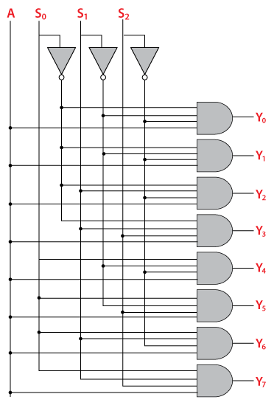
LOGIC DIAGRAM for 1X8 DE-MULTIPLEXER

